Slide 1

Analyse your data through visualization

Slide 2
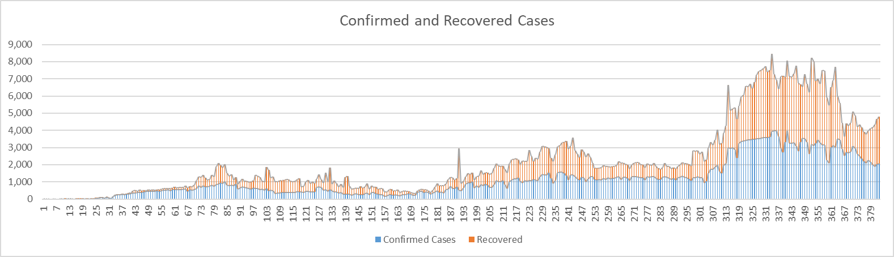
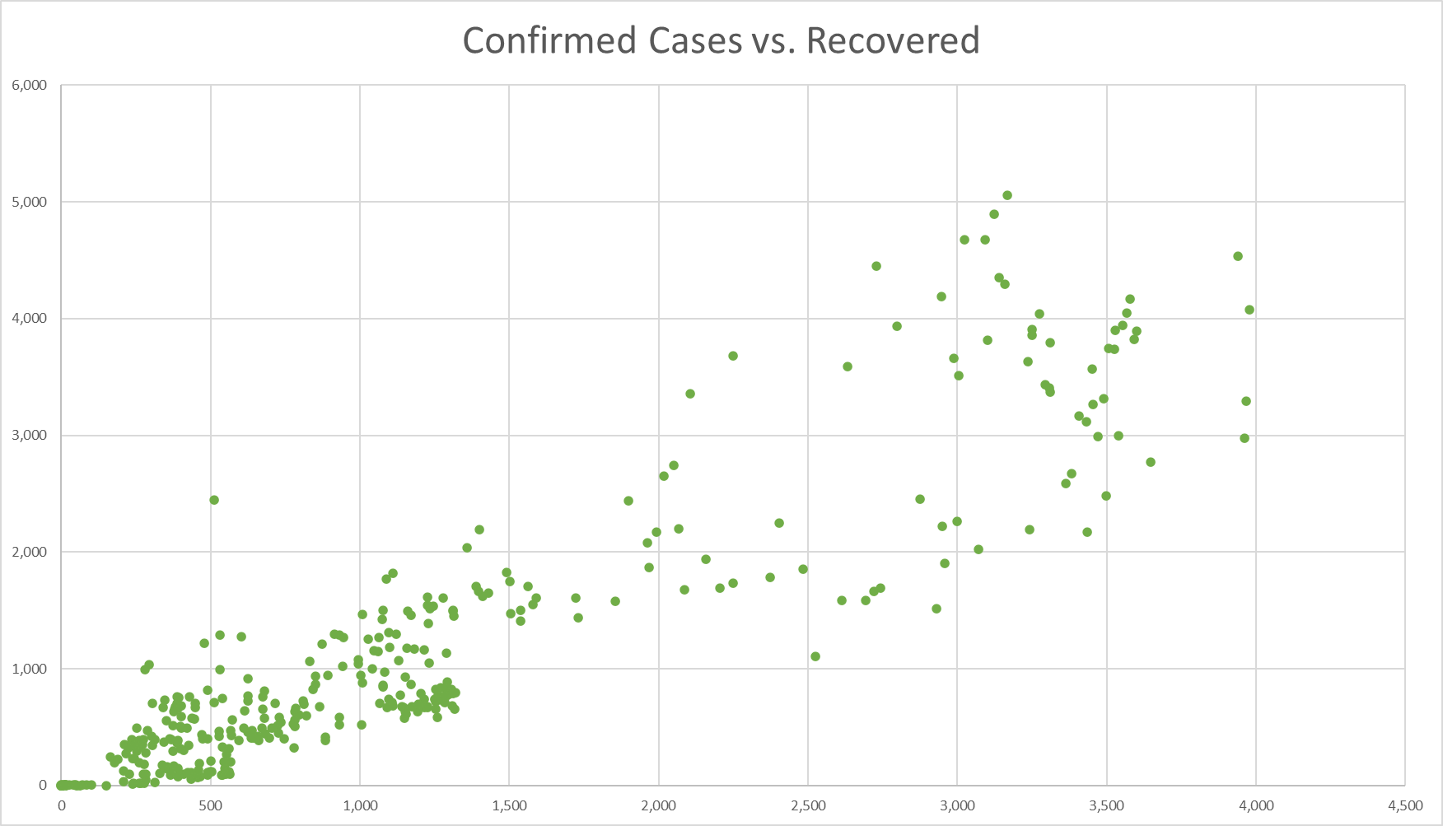
Clear positive correlation (relationship evident)
Confirmed cases increase, so do recoveries
Why?
Meriam Mkadmi

Slide 3
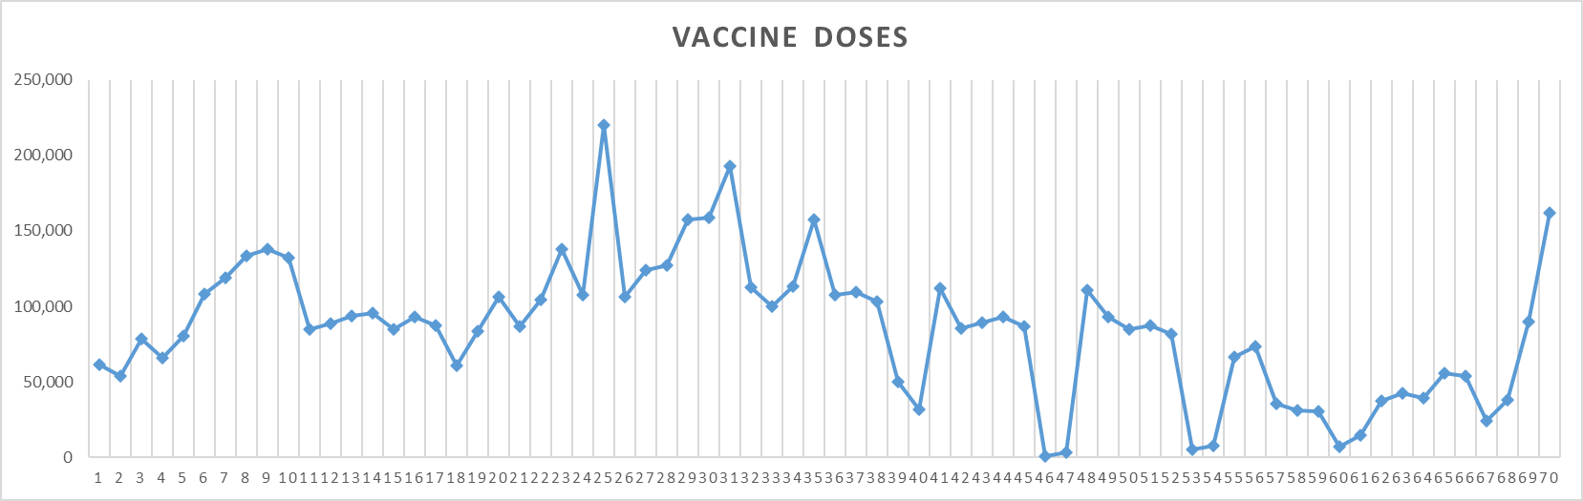
Lets do it in python!
plt.plot(data[‘Day’], data[‘Vaccine’], ’blue’)
plt.show()
Why such a large drop?
Meriam Mkadmi

Slide 4
What happened on Day 50?
Why did it increase after Day 50?
Vaccine Dose 1: Day 1 onwards
Vaccine Dose 2: approx. 21 – 28 days after Dose 1
Fully Vaccinated: approx. 21 – 28 days after Dose 2
Natasha Madhu

Slide 5
Since Day 50 (many fully vaccinated), #confirmed cases show negative trend (fewer new cases daily!)
This week, record lowest since vaccines have been administered
Since Day 50 (many fully vaccinated), #confirmed deaths also show negative trend
Just a week ago (Day 70), as few as 4 confirmed deaths – least since January (Day 16)
Natasha Madhu

Slide 6
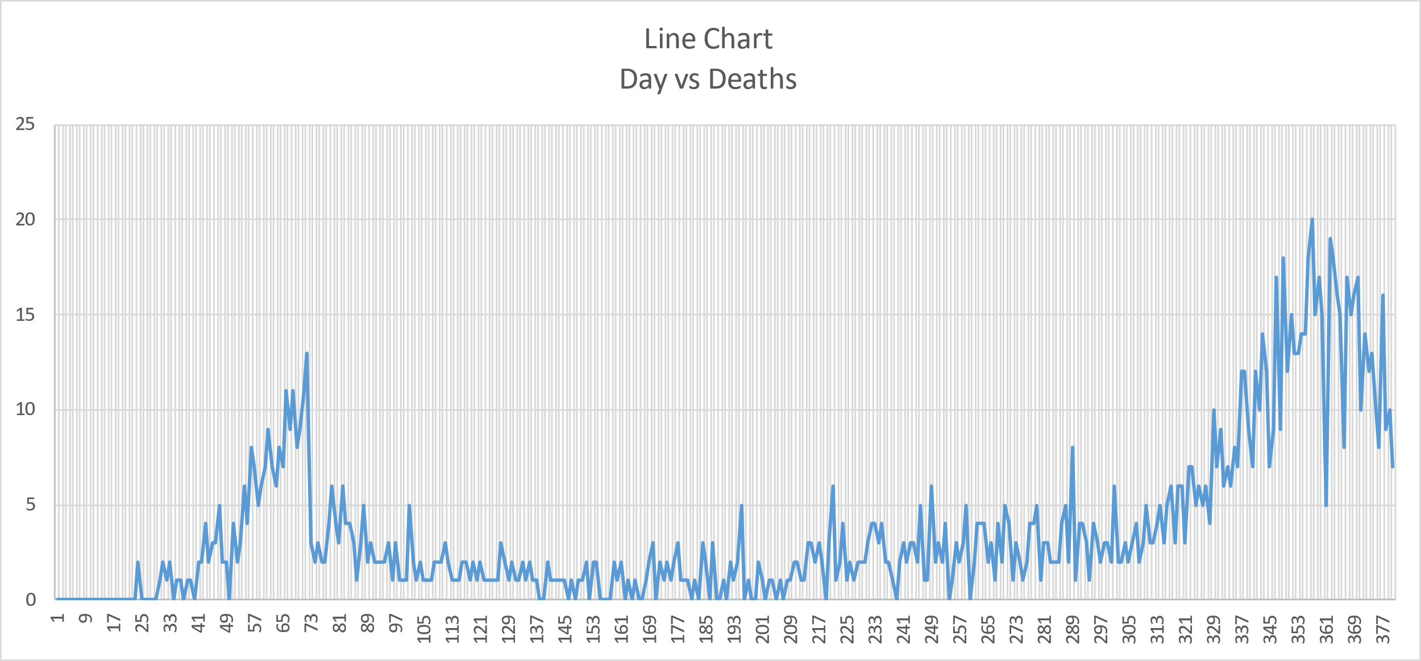
Whys there a sharp drop?
Meriam’s suggestion: Lets see what kind of correlation is there between new cases and deaths
Lets use Python!
Radi Riyas

